Slide 1
IoT-enabled sensor for water quality prediction using machine learning
Name: Palok Biswas
Matric Number: WOA180016
Supervisor: Dr. Zati Hakim Azizul Hasan
Department: Artificial Intelligence, FCSIT

Slide 2
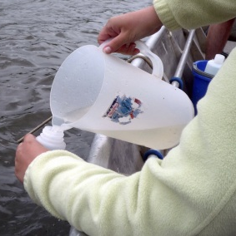
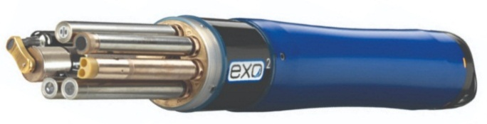
Background
About 60% of Malaysian lakes suffer from eutrophication
Eutrophication or algal bloom is caused by excessive organic nutrients (a by product of human activities)
For prevention, NAHRIM proposed continuous water sampling to detect degradation at early stages
Currently, water sampling is done manually, involving expedition with boats
Preferably done in-situ by dipping hand-held sonde into water
Common 5 parameters to sample include pH, temperature, conductivity, turbidity and dissolve oxygen (Koparan, 2018)
For eutrophication, usually test in the lab for Chlorophyll-a
Grab sampling method (Ore et al., 2015) and the EXO sonde

Slide 3

Background
3-types of commercially available water quality in-situ sensors
Ion-Selective Electrode (ISE)
Wet Chemical
Optical Sensor
Most cost effective but susceptible to inaccuracies and drifting
Both are very precise but very expensive & require heavy maintenance
Often these in situ sensors are expensive and not IoT-enabled
Data is recorded in USB and manually transferred from sonde to another platform for processing
Less feasible for continuous real-time monitoring
State-of-the-art in water sampling (EXO GO catalogue, 2019)

Slide 4

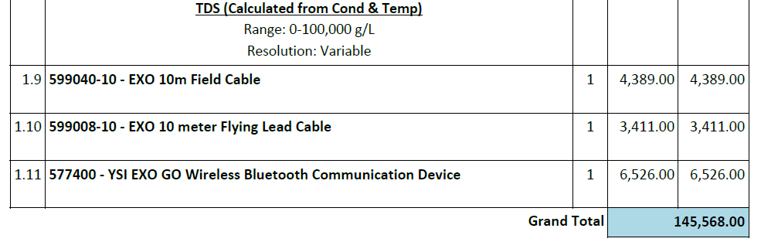
Motivation
As a rough guideline on the cost, a normal sonde with 5 common water parameters i.e. pH, temperature, conductivity, turbidity and dissolve oxygen costs RM41,000
To include IoT-enabled features, require another RM76,000
Sample quotation for EXO GO with IoT-enabled, 2019 Inclusive of total algae parameters

Slide 5
Motivation
Development of Soft Sensor
It is possible to predict the parameter based on other available water quality parameters using a machine learning model and is termed a soft sensor (Castrillo & García, 2020).
Algorithms like ANN is a good example of inductive modelling that can predict parameters like Chlorophyll-a (Tian et al., 2017) from 5 basic water parameters i.e. pH, temperature, conductivity, turbidity and DO
Deductive Model
Inductive Model
Requires deep understanding of bio, chem and physical processes. Highly time consuming
Focused on statistical correlation of features and patterns of sampled data over time

Slide 6
Literature Review
Chlorophyll-A Prediction
Reference | Aim | Algorithm | Findings | Gap
Huo et al. (2013) | Eutrophication (Algal bloom) prediction and tropic state of the water body is determined by predicting chlorophyll-a which is the prime indicator for eutrophication | Back Propagation NN | Nonlinear relationship between Chl-a and input parameters | Requires a lot of input parameters
Zhang et al. (2016) |  | Deep Belief Network | Dependent on meteorological, hydrological and other biochemical processes | Most input parameters cannot be measured in real time
Tian et al. (2017) |  | Back Propagation NN | Temp, TSS, TP & NP influence Chl-a and Transparency | Trained on a limited dataset
Yi et al. (2018) |  | Extreme Learning Model | Region of rivers have different | Predictive models are specific to a particular waterbody
Mamun et al. (2020) |  | Support Vector Machine | Rainfall, solar radiation | Relies on expensive sensors and sensitive to de-calibration
Jimeno-Sáez et al. (2020) |  | Support Vector Regression | Chl-a data is a non-stationary time series process which makes prediction difficult

Slide 7
Literature Review
WQI Prediction
Reference | Aim | Algorithm | Findings | Gap
Camejo et al. (2013) | Water Quality is assessed to estimate the WQI and also water is also classified according to the water quality standards | k-Nearest Neighbour, | Deep learning outperforms other models like kNN & SVM | SVR relies on a lot of input parameters
Yan et al. (2017) |  | Extreme Learning Machine |  | Trained on a limited dataset
Shafi et al. (2018) |  | Deep Neural Network |  | Some parameters cannot be measured in real time
Ahmed et al. (2019) |  | Gradient Boosting & Polynomial Regression
Li et al. (2019) |  | Hybrid Support Vector Regression

Slide 8
Literature Review
Parameter Retrieval
Reference | Aim | Algorithm | Findings | Gap
Keller et al. (2018) | Retrieved certain water quality parameters that cannot be measured in situ in order to enable instantaneous remote sensing | ANN, SVM, Extremely Randomized trees (ET), | Neural Networks are superior when it comes to parameter retrieval compared to other ML models | Satellite images are not available in cloudy and dusty weather
Ruescas et al. (2018) |  | Random Forest Regression, Gaussian Process Regression |  | Hyperspectral or Multispectral radiometers are very expensive
Hafeez et al. (2019) |  | ANN
Shehhi & Kaya (2020) |  | Regression & Neural Network (Nonlinear Auto Regressive)

Slide 9
Problem Statement
In situ sampling is preferred for continuous real-time monitoring of water quality but there is no cost-effective sensor for chlorophyll-a
Chlorophyll-a can be predicted using machine learning models with 5 basic water parameters; pH, temperature, conductivity, turbidity and DO
Hypothetically, IoT-enabled sensor with 5 basic water parameters will be able to effectively model chlorophyll-a concentration to determine eutrophication level at lakes

Slide 10
Research Questions | Research Objectives | Research Methodology | Research Outcome
What are the various methods used for lake water sampling? What are the parameters important for Chl-a prediction? | To study different monitoring methods and parameters for efficient lake water sampling and parameters required to accurately predict Chlorophyll-a | Literature search Systematic literature review | Findings on the performance of existing approaches Core parameters for water quality monitoring and Chlorophyll-a prediction
How accurate are the in-situ measurements compared to laboratory equipment? | To compare the IoT sensor data with laboratory equipment for the same water samples. | Proof-of-concept Calibration of sensors Data collection from IoT sensor and lab equipment Accuracy and precision test | Custom-built IoT-enabled sensor Develop firmware and integrate with the backend Training and Validating appropriate machine learning model for prediction Visualize the data on the backend
Is the proposed prototype a feasible solution for a real-time lake water sampling? | To test the performance of the proposed prototype in real-time | Providing water quality researchers our sensor for data collection | New findings on the proposed prototype in terms of feasibility and accuracy
How does the performance of the proposed prototype differ from standard methods? | To evaluate and compare the performance of the proposed prototype with standard methods of measurement | Comparative evaluation | Results of performance comparison with existing solutions

Slide 11
Scopes of the Study
Development of Low Cost Soft Sensor for Chlorophyll-a
Sensor Selection
Microcontroller Selection & Firmware
Backend Communication and Functionality
Low cost water quality sensor by DFRobot
Analog pH Sensor (SEN0161-V2)
Digital Temperature Sensor (DS18B20)
Analog Electrical Conductivity Sensor Meter (SKU DFR0300) Analog Turbidity Sensor (SKU SEN0189)
Analog Dissolved Oxygen Sensor (SEN0237-A)
ESP32 microcontroller, a 32-bit low cost, low power system on a chip (SoC) with Wi-Fi connectivity
C programming language
Lightweight Message Queuing Telemetry Transport (MQTT) protocol over SSL
The sensor data is sent using MQTT in a json packet

Slide 12
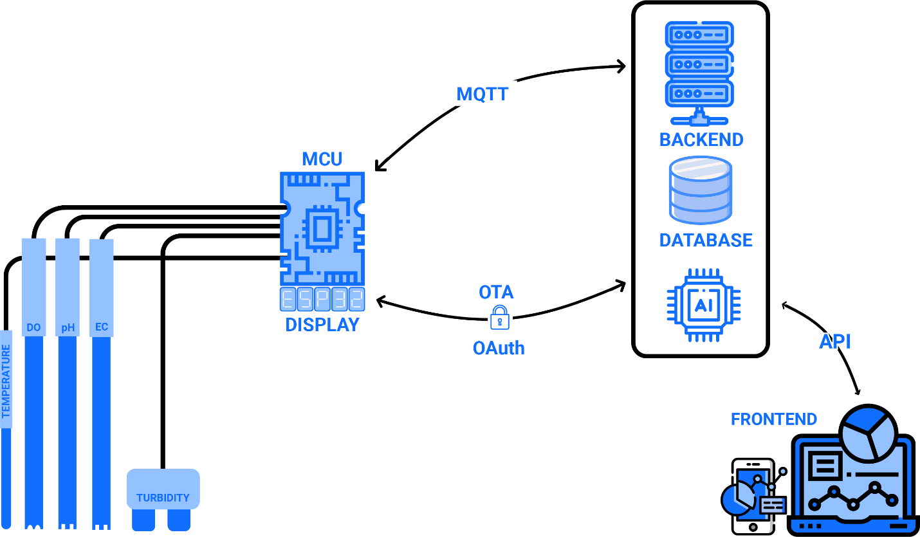
Proposed Solution

Slide 13
Methodology
Prototype development for low cost IoT-enabled sensor with 5 basic water parameters (completed)
Sensor calibration
Machine learning model for chlorophyll-a prediction
Testing and evaluation

Slide 14
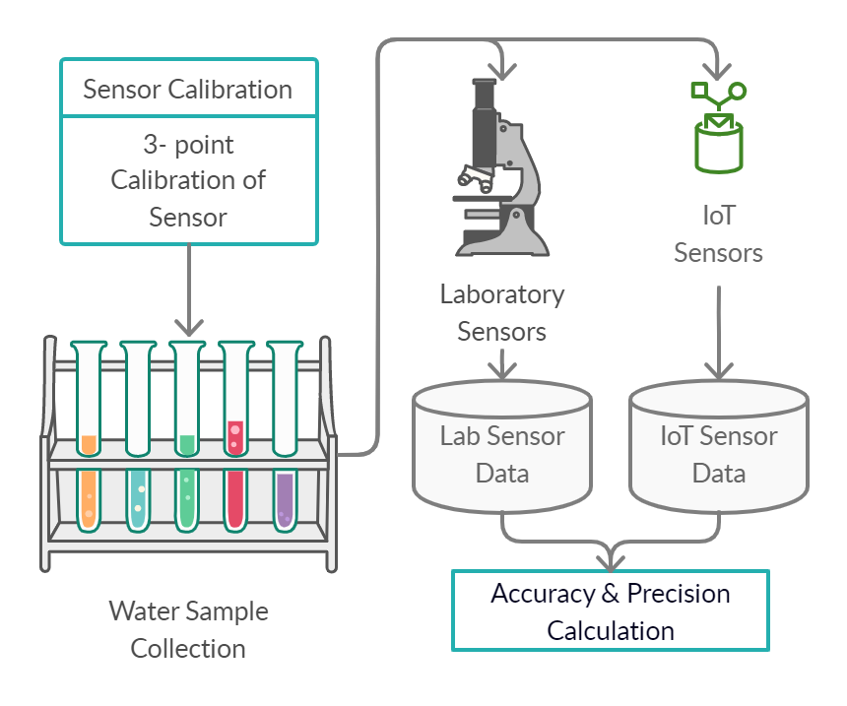
Methodology
Sensor calibration (on-going)
Step 1: calibrate using standard solutions for each parameters
Step 2: calibrate using real water samples with ground truth

Slide 15
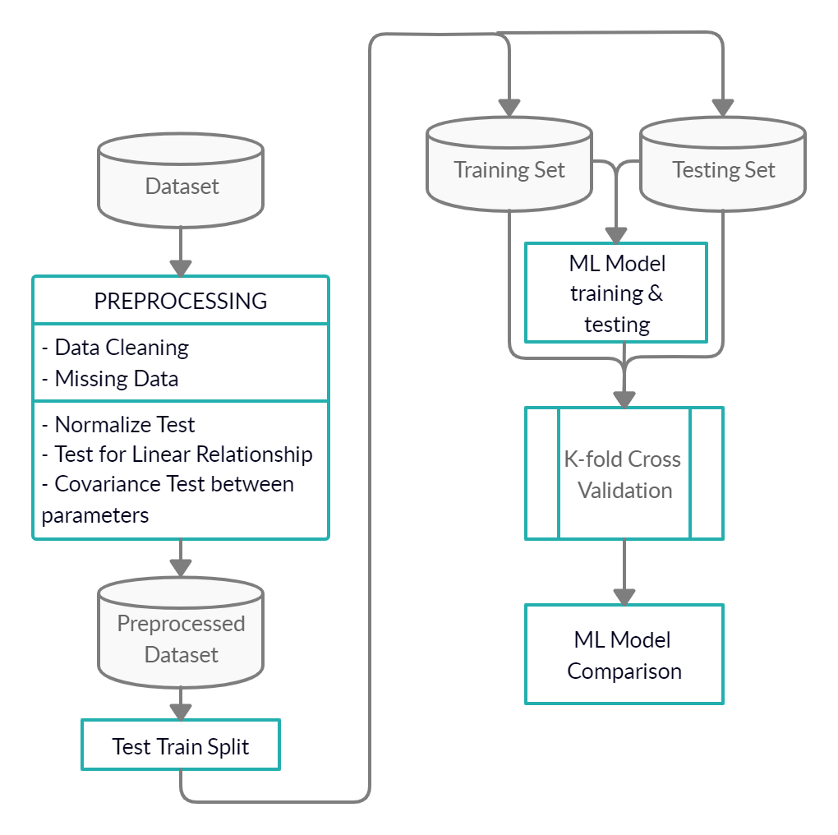
Methodology
Machine learning model for chlorophyll-a prediction
The machine learning models selected for this study (SVM, SVR, Deep Learning, ELM, RF and ANN)
to assess which model performs best, k-fold cross validation test will be used

Slide 16
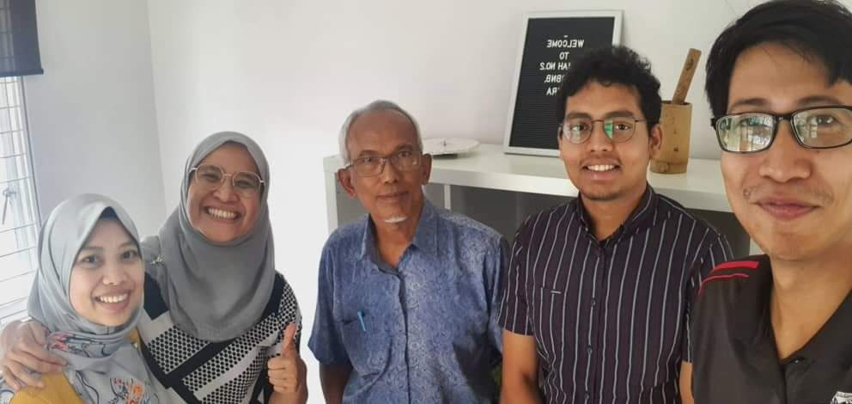
Methodology
Testing and evaluation
User acceptance evaluation by project impact partner, Water Warriors (UM)

Slide 17
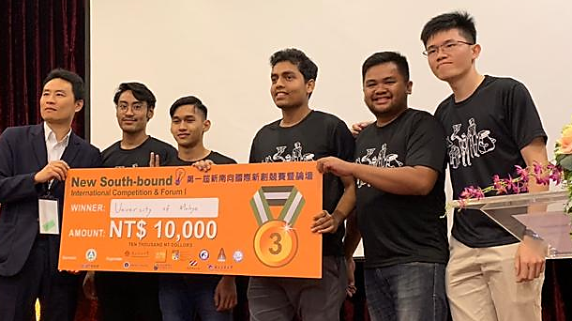
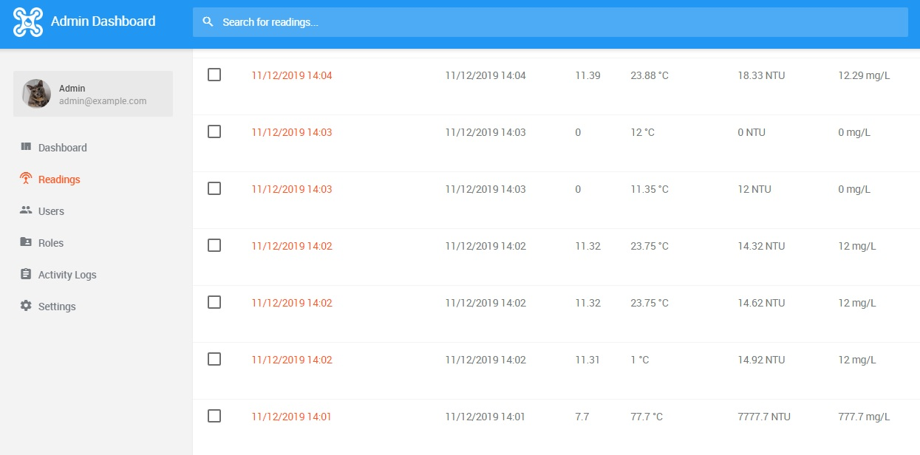
Current Progress/Achievement
Photo of sensor and dashboard
2019 NCKU Maker Festival and International Student Innovation Competition, Taiwan
Won 3rd place for earlier prototype of the IoT-enabled low-cost water quality device

Slide 18
Challenges
Acquisition of time series data for Malaysian lakes
Sv working to get data by DOE through collaborator NAHRIM

Slide 19
Milestones

Slide 20
Conclusion
Significance/Impact of the Study
This research contributes to the improvement of water quality monitoring of water bodies (lakes) in Malaysia. Specifically, it addresses the mitigation measures under the Environmental Quality Act (1974) and more generally, the National Water Resources Policy (2012). It is also related to the SDG6 aspects in the upcoming Rancangan Malaysia ke-12, especially on integrated water resource management

